Slide 1
ORDER OF ST. AUGUSTINE
International Commission for Augustinian Centers of Education
Augustinian Education Congress 2017
Villanova University, USA
24-28 July 2017
Theme:
Augustinian Pedagogy: A Passion for Education
Notes:
To use this title animation slide with a new image simply 1) move the top semi-transparent shape to the side, 2) delete placeholder image, 3) click on the picture icon to add a new picture, 4) Move semi-transparent shape back to original position, 5) Update text on slide.

Slide 2
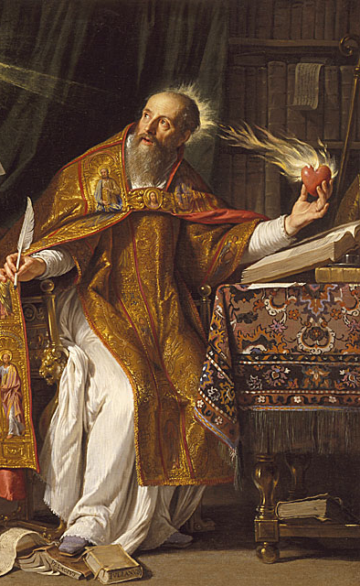
Passion for
Augustinian Spirituality
The Love of Knowledge
and Search
for Truth
Andrew P. Batayola, O.S.A.

Slide 3
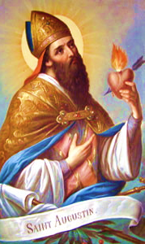
“O truth, O truth, how deep is the yearning for you in the inmost depths of my being”

Slide 4
“Greatest esteem for educational apostolate and consider it as one of the special mission of our Order”
Const 161

Slide 5
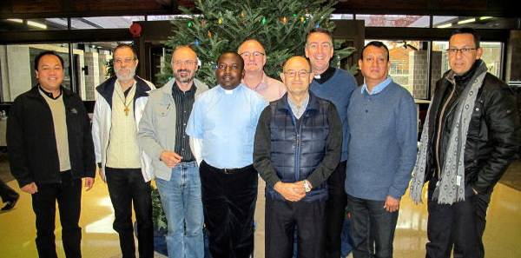
“to strengthen the Augustinian culture and spirituality in our schools”

Slide 6
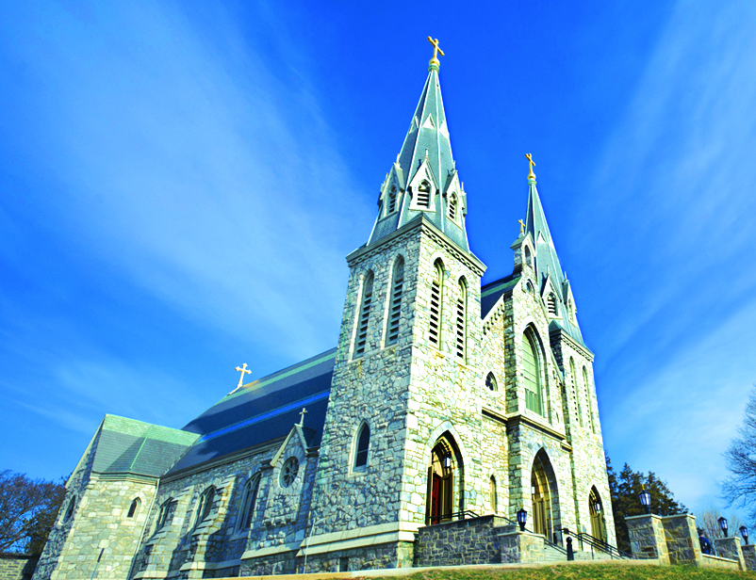
Passion to Speak about Spirituality

Slide 7
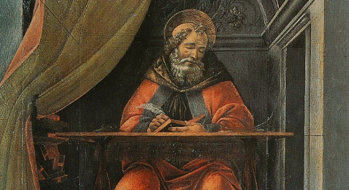
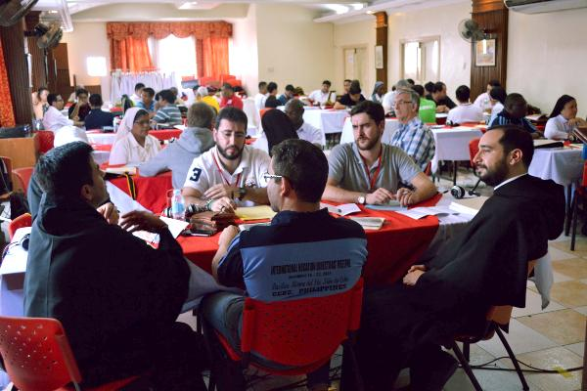
Augustinian Pedagogy:
A Passion for Education
“The love of knowledge and truth should invite us to continue learning. The love of others should compel us to teach.”

Slide 8
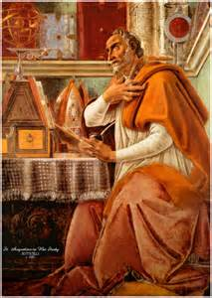
Passion for
Augustinian Spirituality
The Love of Knowledge
and Search
for Truth

Slide 9
Flow
FORM
Augustinian Spirituality in Educational Apostolate
RE-INFORM
Various Discussions Related to Knowledge and Truth
TRANSFORM
Challenges for Augustinian Educators Today

Slide 10
FORM
Augustinian
Spirituality
in
Educational
Apostolate

Slide 11
WORD-JOURNEY
SPIRITUALITY
“Window on the Gospel”
(Tarsicius Van Barel, OSA)

Slide 12
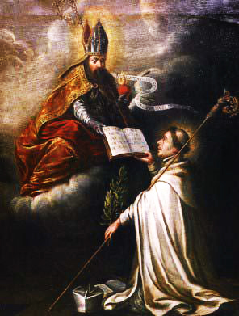
The Principal Document of our SPIRITUALITY is the RULE.
(Constitutionis, 16)

Slide 13
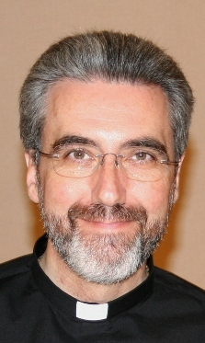
Augustinian Spirituality
The spirituality proper to the Order of St. Augustine that joins the teaching and example of the Bishop of Hippo with the spiritual features of the mendicant movement, all of this as lived and manifested by the Order throughout its history in all its different circumstances of time, place and culture.

Slide 14
AUGUSTINIAN CHARISM
Augustine | Interiority | Communion of Life | Service to the Church
Mendicant Tradition | Search for God | Fraternal Life | Follow the “poor Christ”

Slide 15
“You have made us and drawn us to yourself, and our heart is unquiet until it rests in you”
(Confessions, I,1,1)
Never-ending search for God
offers a “living and integrated account of Augustinian spirituality”
(Robert Russell, OSA)

Slide 16
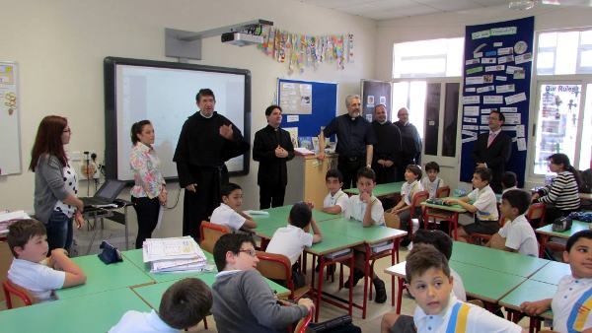
AUGUSTINE’S SPIRITUALITY embraces the Gospel values of:
community
loving our neighbor is a concrete
expression of loving God
development of good relationships
(Tarcisius van Barel, OSA)

Slide 17
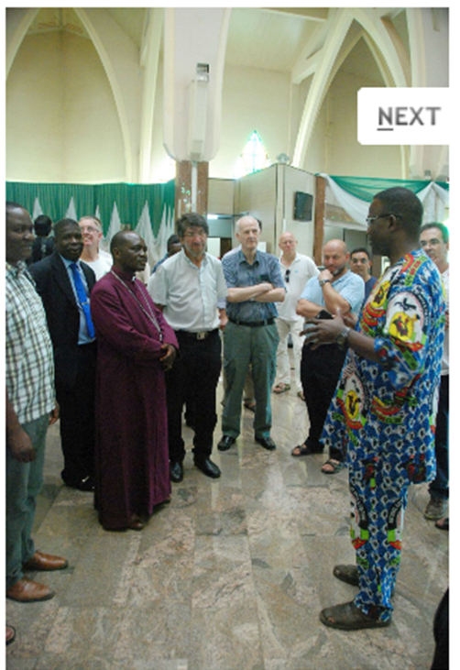
The love for the church brings us to a total availability for its needs, by accepting the tasks which the church asks for us…this availability for service to the Church constitutes one of the essential characteristics of Augustinian spirituality.
(Constitutions, 35)

Slide 18
There are three elements that serve to structure Augustinian Spirituality: the search for God, community and service to the Church
(Miguel Angel Orcasitas, O.S.A.)
COMMUNITY as the core, because it is the scene or stage of the search for God and the structure within which the Church is served.

Slide 19
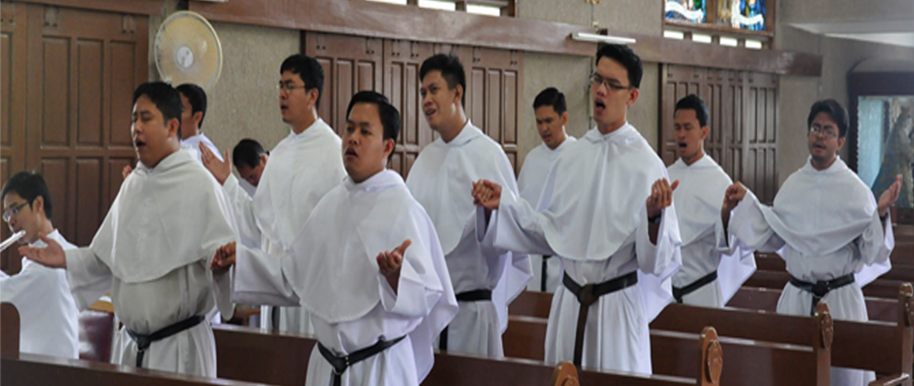
AUGUSTINIAN CHARISM
AUGUSTINE | INTERIORITY | COMMUNION OF LIFE | SERVICE TO THE CHURCH
Mendicant Tradition | Search for God | Fraternal Life | Follow the “poor Christ”
 | Metanoia | Koinonia | Diakonia
 | Conversion | Communion | Commitment

Slide 20
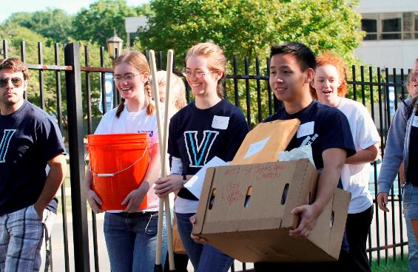
AUGUSTINIAN EDUCATION
CORE VALUES
AUGUSTINE | INTERIORITY | COMMUNION OF LIFE | SERVICE TO THE CHURCH
Mendicant Tradition | Search for God | Fraternal Life | Follow the “poor Christ”
VERITAS | UNITAS | CARITAS

Slide 21
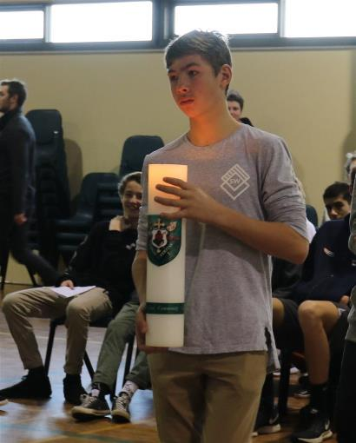
TRILOGY FUNCTIONS OF HIGHER EDUCATIONAL INSTITUTIONS
AUGUSTINE | INTERIORITY | COMMUNION OF LIFE | SERVICE TO THE CHURCH
Mendicant Tradition | Search for God | Fraternal Life | Follow the “poor Christ”
 | Veritas | Unitas | Caritas
RESEARCH | INSTRUCTION: LEARNING COMMUNITY | COMMUNITY SERVICE

Slide 22
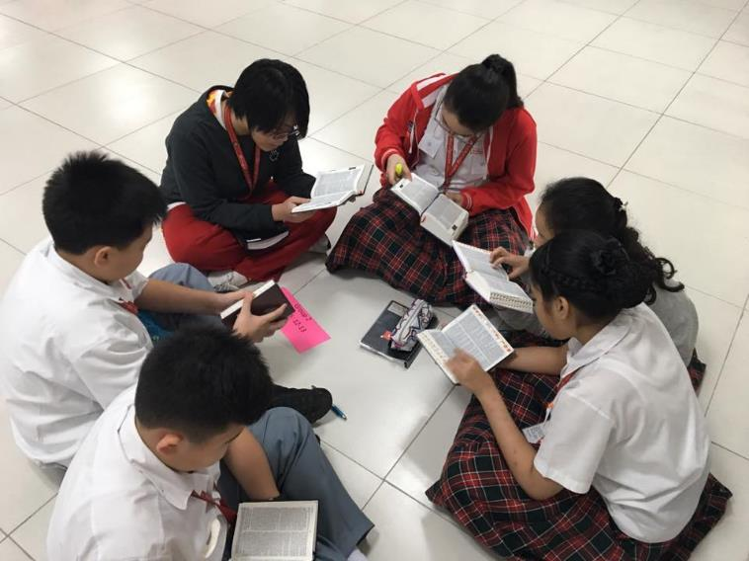
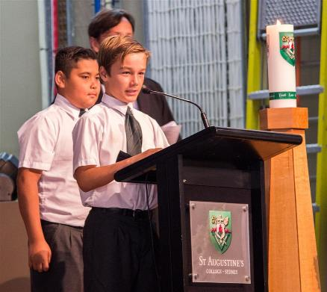
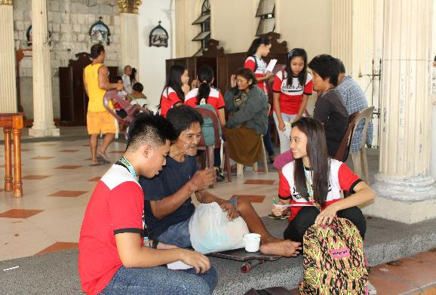
EDUCATIONAL LEADERSHIP
AUGUSTINE | INTERIORITY | COMMUNION OF LIFE | SERVICE TO THE CHURCH
Mendicant Tradition | Search for God | Fraternal Life | Follow the “poor Christ”
 | Veritas | Unitas | Caritas
 | Research | Instruction: Learning Community | Community Service
REFLECTIVE LEADERSHIP | COLLABORATIVE LEADERSHIP | SERVANT LEADERSHIP

Slide 23
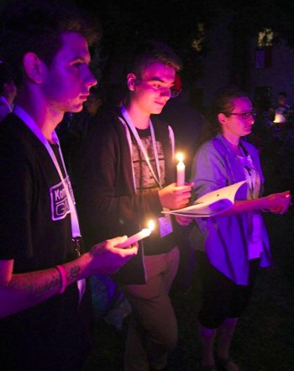
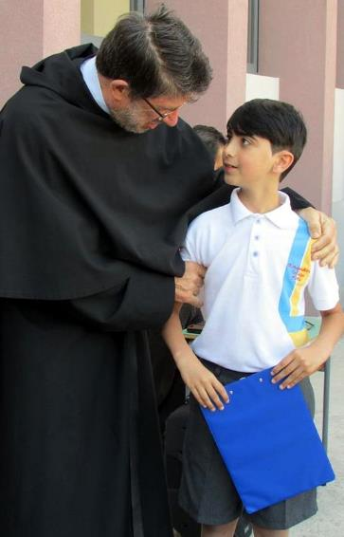
AUGUSTINIAN CHARISM
AUGUSTINE | INTERIORITY | COMMUNION OF LIFE | SERVICE TO THE CHURCH
Mendicant Tradition | Search for God | Fraternal Life | Follow the “poor Christ”
Core Values | Veritas | Unitas | Caritas
HEI’s | Research | Instruction: Learning Community | Community Service
Educational Leadership | Reflective Leadership | Collaborative Leadership | Servant Leadership

Slide 24
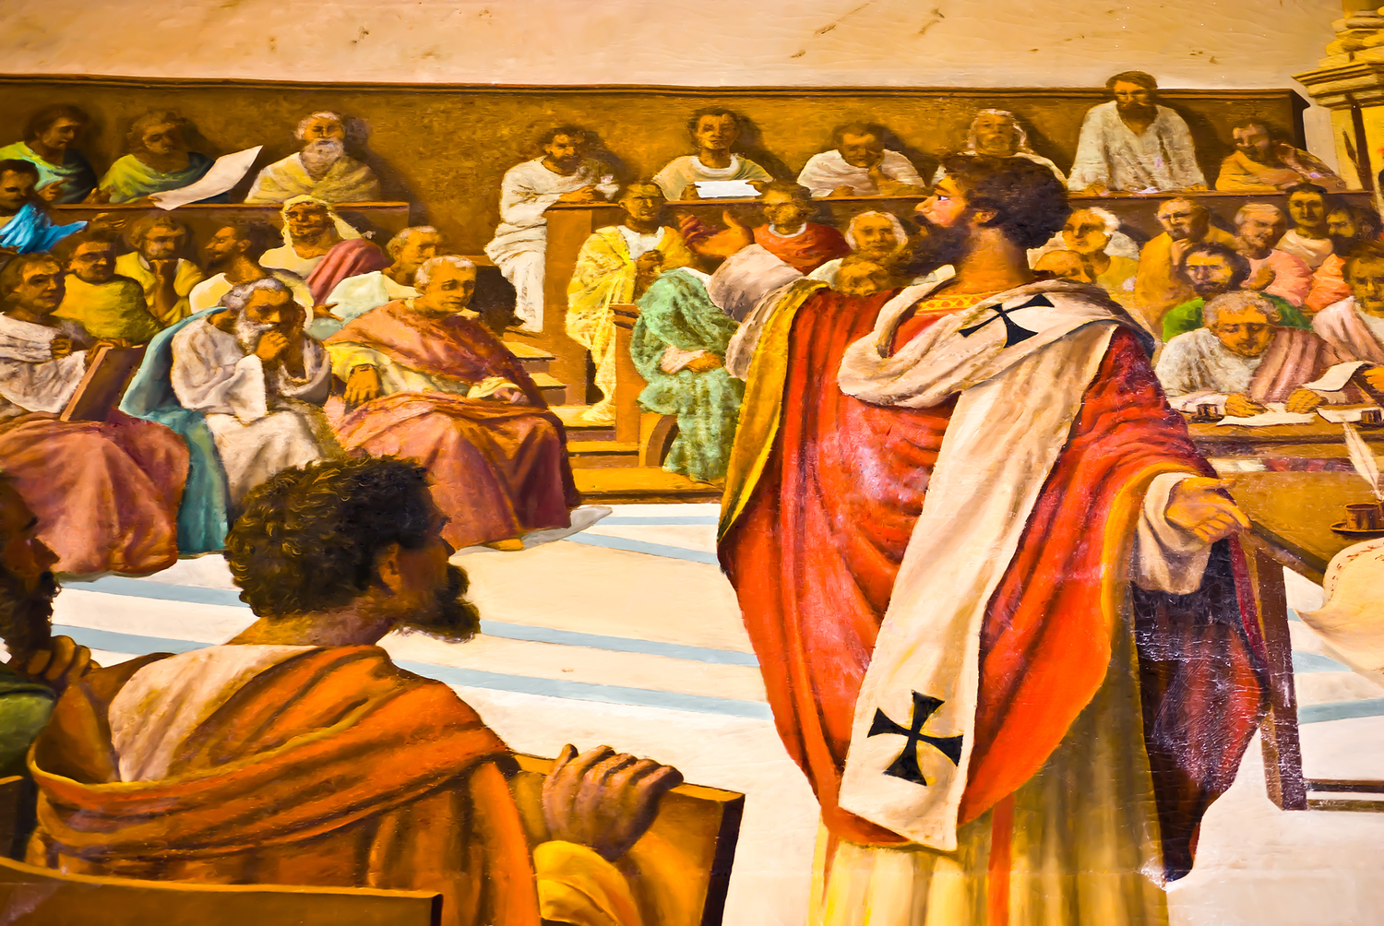
RE-INFORM
Various
Discussions
Related to
Knowledge
and Truth

Slide 25
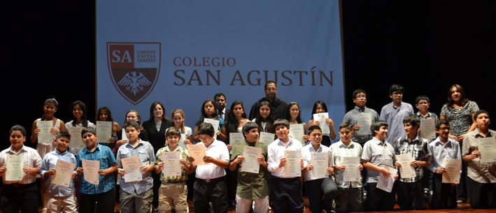
Through Interiority to Truth
Come back to your self. It is in the inner self that truth dwells
(On True Religion 39, 72)
The TRUTH within

Slide 26
TRUTH
is the inheritance of all
“In an Augustinian pedagogy, to learn how to become passionate for learning truth there should be communitarian approaches”
(Gary McCloskey, O.S.A.)

Slide 27
FAITH
&
REASON
His thirst for truth was radical.
Augustine as Student

Slide 28
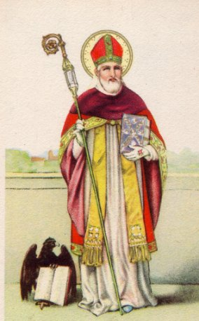
Faith and Reason lead us to Knowledge

Slide 29
I BELIEVE
in order to
UNDERSTAND
I UNDERSTAND
the better to
BELIEVE

Slide 30
VIRTUE & SCIENCE

Slide 31
Concupiscence -
Virtus
Character
Augustinian Education
Intellect
Ignorance –
Scientia

Slide 32
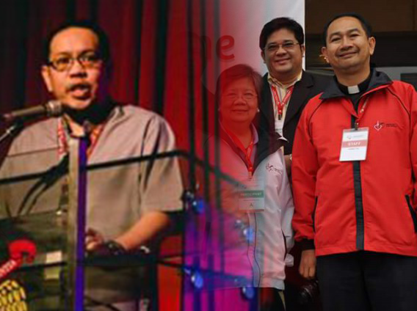
TRANSFORM
Challenges for
Augustinian
Education
Today

Slide 33
1
CHALLENGES
On Being Passionate on Augustinian Spirituality
We need to transmit with fidelity the charism or spirituality of the Order

Slide 34
2
CHALLENGES
On Developing the Gift of Searching
The need for educational plan to create conditions for a person to develop the gift of searching

Slide 35
3
CHALLENGES
On the School With Invites Discovering of the Truth
An Augustinian school – invites discovering of truth through study and living it out through ethical commitment
(cf. Santiago Insunza Seco, OSA)

Slide 36
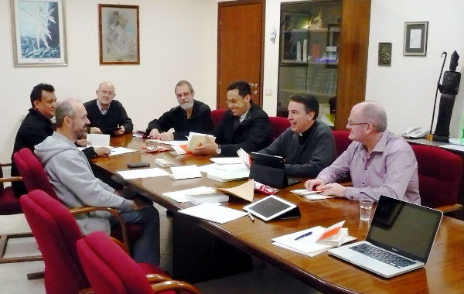
Mandate for Augustinian Educators
FORM:
Augustinian Spirituality & Pedagogy
Devotion to Study and
Pursuit of Wisdom
Encounter the TRUTH within
RE-INFORM:
Pedagogy for Love of Knowledge
and Search for Truth
Person of Christ – the TRUTH
TRANSFORM:

Slide 37
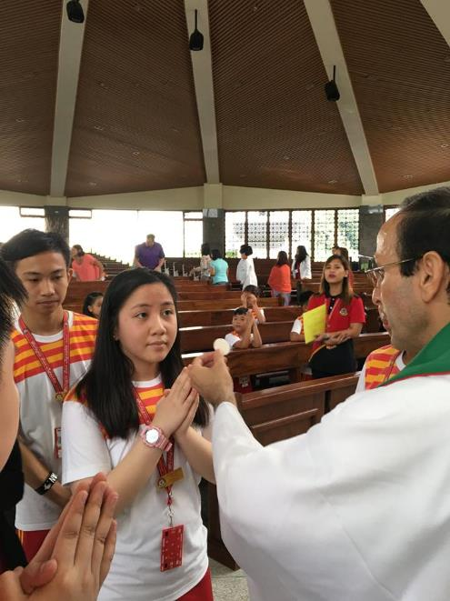
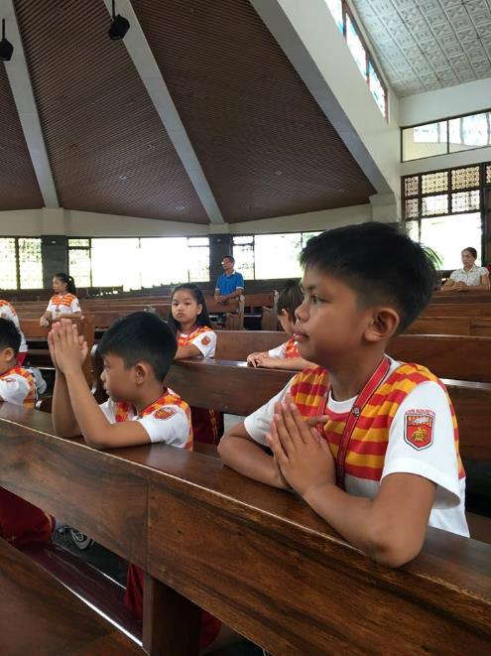
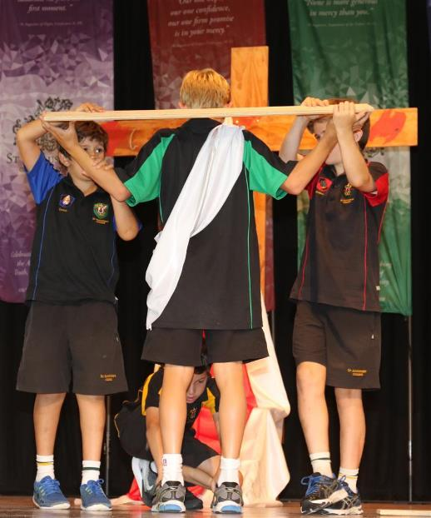
I am the Way,
the Truth and the Life
(Jn 14:6)

Slide 38
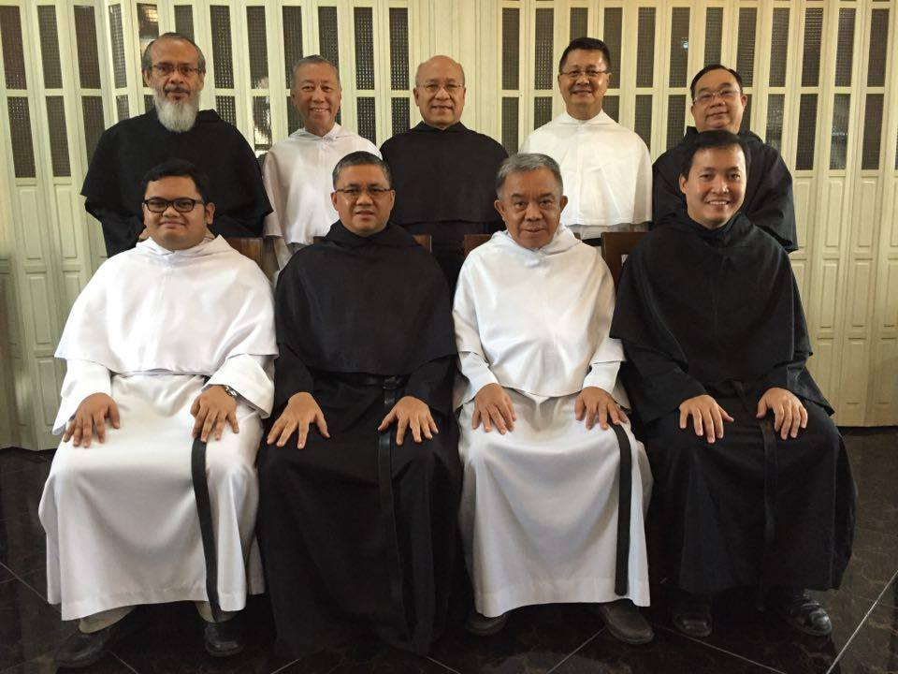

Slide 39
Questions
for
Reflection

Slide 40
Questions for Reflection
1
Considering the culture of the youth and one’s country, what elements of an Augustinian spirituality you consider a challenge in the works of education?
?
2
What can you as consider a great challenge for educational centers related to the becoming of our Augustinian schools that invites discovery of truth?
3
The Augustinian’s devotion to study and the pursuit of wisdom are the intellectual dimension of our spirituality. What educational program or plan would you craft to creat the conditions for a person to develop the gift of searching?

